Slide 1
Operational and Tech Due Diligence
Guidebook
Only for internal Use
October 2022

Slide 2




Agenda
1
2
Operational and Tech Due Diligence roles and areas of analysis
Operational Due Diligence
3
4
Tech Due Diligence
Credentials and CVs
Reliance restricted and confidential – Only for Internal Use

Slide 3








Operational and Tech Due Diligence occurs during the Pre-Signing phase of a transaction and allows to identify points of attention, constraints and upsides both on the operational and technological side
1
2
3
4
Operational and Tech Due Diligence Role
WHEN
During the transaction Pre-Signing phase, Operational and Tech Due Diligence activities provide useful insights to drive the transaction related decision and could highlight activities for the post-deal integration
FINANCIAL DUE DILIGENCE
TAX & LEGAL DUE DILIGENCE
HR & PENSIONS DUE DILIGENCE
Signing
Closing
Pre-signing
Pre-closing
Post-closing
COMMERCIAL DUE DILIGENCE
SELL-SIDE
EY vendor due diligence
Post-closing support
Operational and Tech
due diligence
Separation
delivery
Separation planning
CARVE-OUT DUE DILIGENCE
BUY-SIDE
EY buy-side due diligence
Post-deal value creation: transformation and synergy realization
TECH DUE DILIGENCE
Integration
delivery
Support for day 1 IT and Ops readiness
Operational and Tech due diligence
Operational due diligence as part of the FDD report for the refinancing exercise
OPERATIONAL DUE DILIGENCE
Reliance restricted and confidential – Only for Internal Use

Slide 4








Operational and Tech Due Diligence focus on specific areas of analysis and can be tailored on the characteristics of the deals
1
2
3
4
Operational and Tech Due Diligence Areas of analysis
OPERATIONAL DUE DILIGENCE
TECH DUE DILIGENCE
Operating Model
& Organization
After-Sales
& Customer
Service
Supply Chain
& Logistics
Sales footprint vs operations
Support Functions & Overheads
Technological
landscape
Application Landscape & Architecture
Infra, network & distributed IT
Business continuity and DR
Business process coverage
KEY AREAS
Procurement
& Stock
Procurement & Purchasing
Inventory management
KEY AREAS
IT Operating
Model &
Organization
IT Organization and skills
IT Processes
& Governance
IT Contracts & Suppliers
Operations & performances
Productivity
& Utilization
Manufacturing &
Operations
Investment
needs & CAPEX
IT Financials
IT Capex /
Opex
IT Budget review
R&D
Research &
Development
Business linkage
Alignment with Business Strategy
IT projects portfolio
Reliance restricted and confidential – Only for Internal Use

Slide 5
Agenda
1
Operational and Tech Due Diligence roles and areas of analysis
2
Operational Due Diligence
Key benefits and areas of analysis
Scope of Work – Example
Timeline
Case Study: Manufacturing Target
3
4
Tech Due Diligence
Credentials and CVs
Reliance restricted and confidential – Only for Internal Use

Slide 6





By investigating 4 main areas of analysis, OPS Due Diligence assess whether operations are suitable to the business model or if improvements are required and/or potential upsides could be obtained after the deal
1
2
3
4
Key benefits and areas of analysis
MAIN GOAL
Operational Due Diligence aims to find out whether operations can support the business as usual and any growth strategy from the business plan or if there are any potential gaps or improvement areas to get upsides
Key areas of analysis
Operating Model & Organization
Understand if the operating model and the organizational structure are suitable to the business model and if the resources are adequate to business in terms of number, right distribution and required skills
Procurement & Stock
KEY BENEFITS
Investigate if the procurement and inventory management strategies can be optimized
Productivity & Utilization
R&D
Assess the production capacity of the facilities to understand if it is state-of-the-art or requires further investments to support production and growth
Clearly define shared knowledge and R&D process in order to prevent risks of leakage and value loss
Reliance restricted and confidential – Only for Internal Use

Slide 7
The analyses related to the 4 focus areas is tailored according to the Target to be addressed by the Operational Due Diligence
1
2
3
4
Scope of Work - Example
Manufacturing Company
Service Company
Map current organization structure and FTEs per function
Analysis and comment on historical personnel cost evolution (including temporary workers) concerning white collars
Understand the Operating Model
Comment on Make VS Buy approach per function
Analyze key roles and critical competences for customer management
Understand Operating Model, map current organization structure/FTEs
Analysis and comment on historical personnel cost evolution
Comment current Customer Relationship model (o/w Direct and Indirect) Comment on Make VS Buy approach per function
Analyze key roles and critical competences
SG&A costs analysis and support for cost saving opportunities
Operating Model & Organization
Procurement spend analysis – 80:20 materials/suppliers (curr. and hist.)
Comment on procurement organization and strategy (e.g. global vs local)
Comment on historic trends and forecast assumptions
Comment on current/recent cost reduction activities (strategy, execution, results already achieved, result expected…) if any
Exposure to commodity markets – comment on risk and price management
Comment on procurement strategy and level of maturity
Procurement spend visibility analysis – 80:20 for HWs/ SWs/ Services and suppliers (current and historical)
Comment on procurement organization (e.g. global vs local)
Comment on historic trends and forecast assumptions
Comment on current/recent cost reduction activities (strategy, execution, results already achieved, result expected, etc) if any
Comment on procurement strategy and level of maturity
Procurement & Stock
Comment on key productivity drivers – scale, reliability, changeovers...
Comment on output constraints – shift patterns, factory layout, logistics
Analysis and comment on historical personnel cost evolution (including temporary workers) concerning blue collars
Labor productivity (direct labor cost variation, temporary employment…)
Comment on production saturation levels
Comment on demand planning process
Comment on capacity for any forecast growth
Comment on recent improvement program, results and sustainability
Comment CAPEX trends and identify possible need for additional Capex
Comment on key R&D drivers and KPIs
Comment CAPEX trends and identify possible need for additional Capex
Productivity & Utilization
Comment on current R&D pipeline management
Comment on risk of knowledge leakage in case of people exit
Comment on R&D process and organization and its eventual relevance
Map and comment on eventual patents
Comment on current R&D pipeline management
Comment on level of know how internalization
Comment on risk of knowledge leakage in case of people exit
R&D
Reliance restricted and confidential – Only for Internal Use

Slide 8
4 weeks is the average duration of an Operational Due Diligence, with the sharing of a Red Flag report about halfway through the analyses
1
2
3
4
Timeline
WEEK 1
WEEK 2
WEEK 3
WEEK 4
PRELIMINARY
ANALYSIS
Access to VDR
Red Flag Report
Final Report
Documents study
IRL preparing and sharing with the Seller
1st analysis drafting
RED FLAG
REPORT
Mgmt. Presentation
Based on documents in the VDR
Site visit
Red flag report preparation
If necessary for other deep dives
FINE-TUNING
Update IRL sharing
Site visit
Deep-dive meeting with target mgmt.
Analysis fine-tuning
FINAL
SHARING
Deep-dive meeting with target mgmt.
Complete analysis
Share of final report
Milestone
Reliance restricted and confidential – Only for Internal Use

Slide 9




Operational Due Diligence have been conducted to support Datalogic Team in the acquisition of a player operating in Sensor & Safety business and consequent integration
1
2
3
4
CASE STUDY: MANUFACTURING TARGET – Project overview (1/5)
Transaction Overview
Relevant KPIs
The transaction involving Datalogic aimed to strengthen its position in the Sensors & Safety and Machine Vision business
In order to reach this goal, the Company has decided to acquire a player in the market and to then perform a carve-out on its Sensor & Safety and Machine Vision BU with the aim of combining it with the acquired target
The Company needed to perform Due Diligence activities to assess the “as is” situation of the potential target, including Operational DD
4 weeks of Operational Due Diligence
Consolidated revenues of ~€25m (FY20)
+ 200
employees
Related to transaction perimeter
Key Areas of Analysis
The aim of the Operational Due Diligence was to highlight and discuss the main areas impacted by the transaction and by the subsequent integration between the Company and the buyer
Operating Model & Organization
Procurement & Stock
Productivity & Utilization
R&D
Reliance restricted and confidential – Only for Internal Use

Slide 10
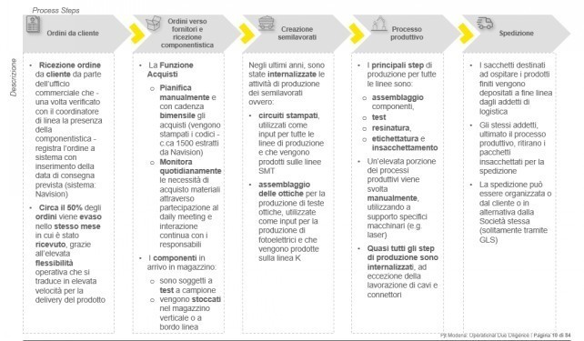
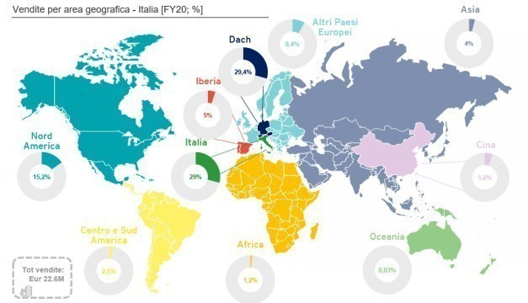
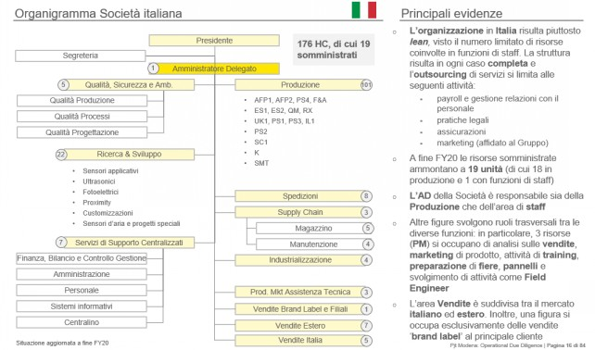
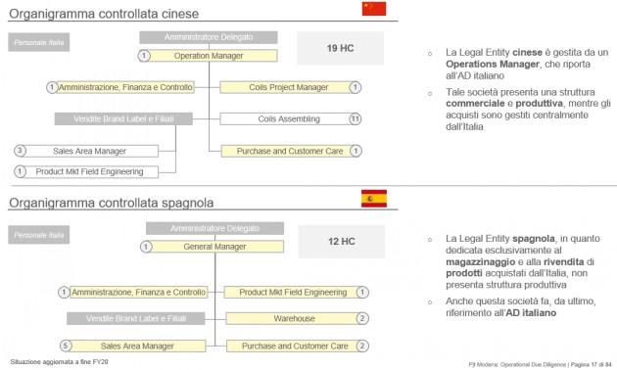
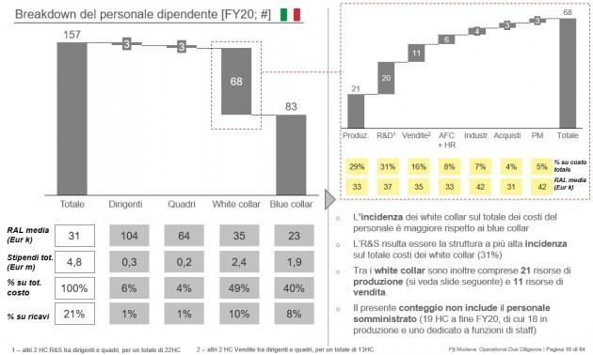
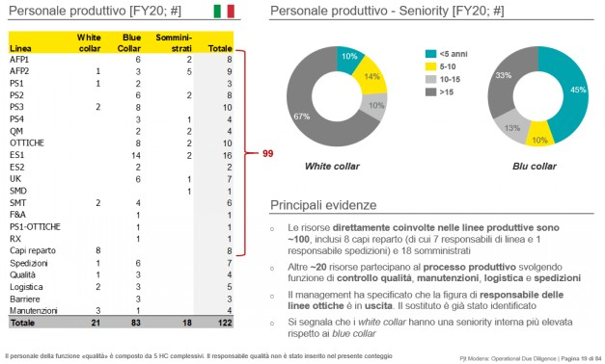
An assessment of the Operating Model & Organization was conducted to understand the level of complexity of the Company and the adequacy of the employee base
1
2
3
4
CASE STUDY: MANUFACTURING TARGET – Operating Model & Organization (2/5)
Analyses and key insights
Operating Model overview
An initial analysis concerned the Company's Operating Model with the geographic location of the sites, the overview of sales by geographic area and by product as well as the development plans
Organization assessment
A high-level analysis of the organization was conducted to understand the level of complexity of the Company and its subsidiaries and the adequacy of the profile and the number of resources allocated for each function
Employees breakdown and employees by areas analysis
The breakdown of personnel in the main roles (e.g. executives, white / blue collars...) was conducted to identify their number, cost and average annual gross salary and to highlight the roles with the greatest impact on personnel costs
The analysis of employees by area (Operations, Sales, R&D) highlighted the areas in which potential efficiencies could be pursued
Reliance restricted and confidential – Only for Internal Use

Slide 11
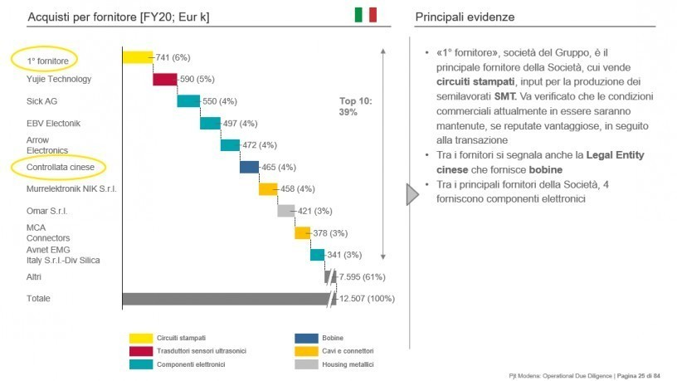
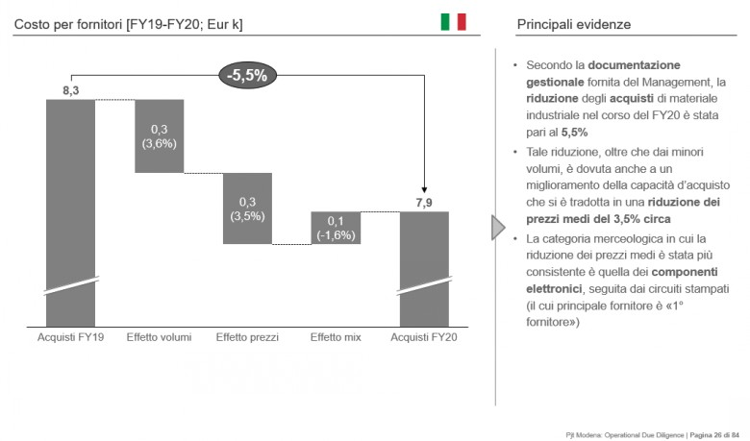
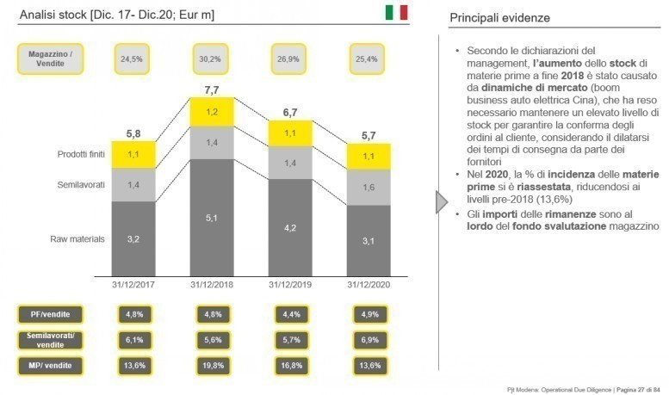
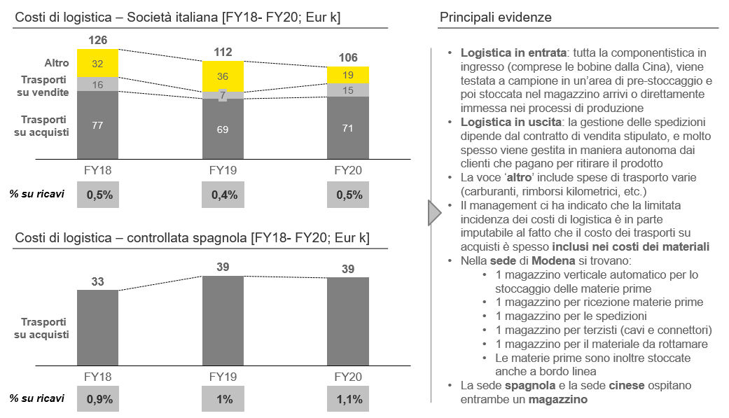
Procurement & stock analysis was performed to highlight the efficiency of purchasing strategy and of the inventory management
1
2
3
4
CASE STUDY: MANUFACTURING TARGET – Procurement & Stock (3/5)
Analyses and key insights
Procurement analysis
An assessment was conducted on the main suppliers and on the Company's procurement strategy to understand the efficiency of purchasing management and potential savings from better purchasing conditions
Inventory management
Warehouse analysis was conducted to identify the dynamics of the stock level in a specific timeframe, the value of raw materials and finished products as well as the incidence of logistics costs to understand whether potential efficiencies could be achieved
Reliance restricted and confidential – Only for Internal Use

Slide 12
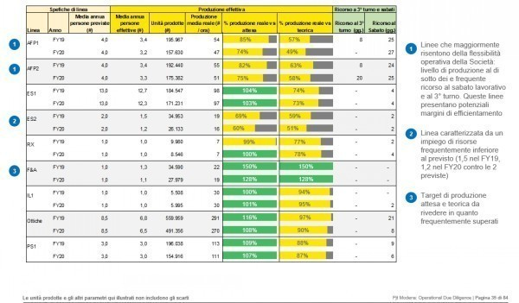
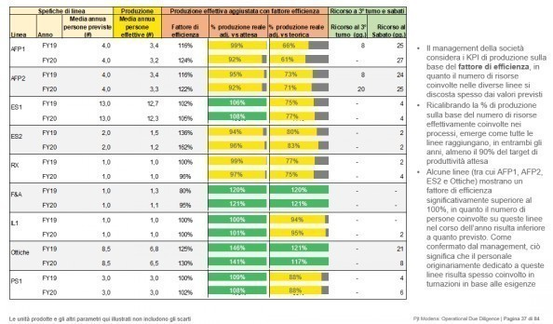
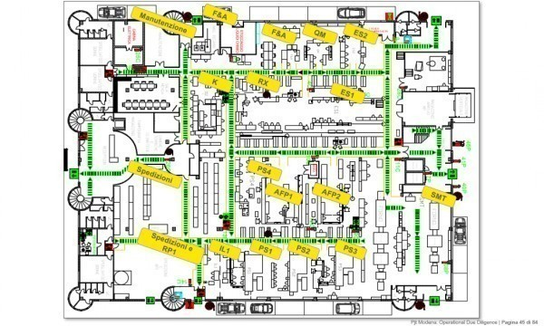
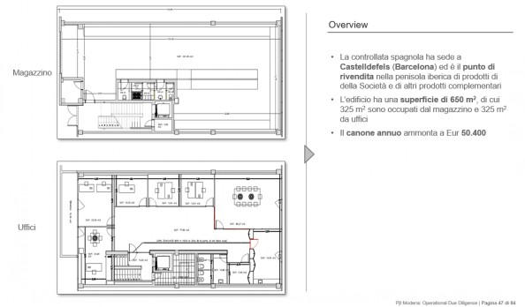
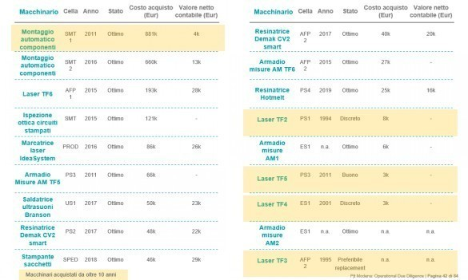
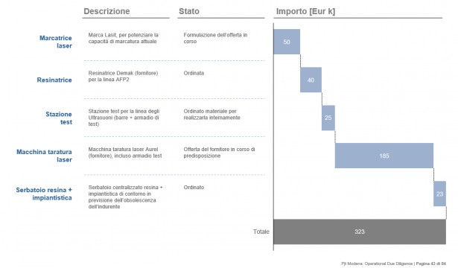
Analysis on productivity was useful to understand saturation levels and space for upsides, while facilities and machinery assessment served to understand the possible need for investment
1
2
3
4
CASE STUDY: MANUFACTURING TARGET – Productivity & Utilization (4/5)
Analyses and key insights
Productivity analysis
The analysis of the productivity levels related to the different lines showed in which cases the production was close to the expected targets and the theoretical productivity levels to understand which lines needed to be improved with targeted actions
Facilities assessment
All the facilities of the Company have been listed, dividing them between those owned and rented and making a mapping to understand the functions of the different areas
This analysis served to understand any need for expansion and consequent investments
Machinery assessment
An assessment of the machinery and planned investments for the various lines has highlighted the state of the Company's machinery and the possible need for replacements with new potential investments
Reliance restricted and confidential – Only for Internal Use

Slide 13
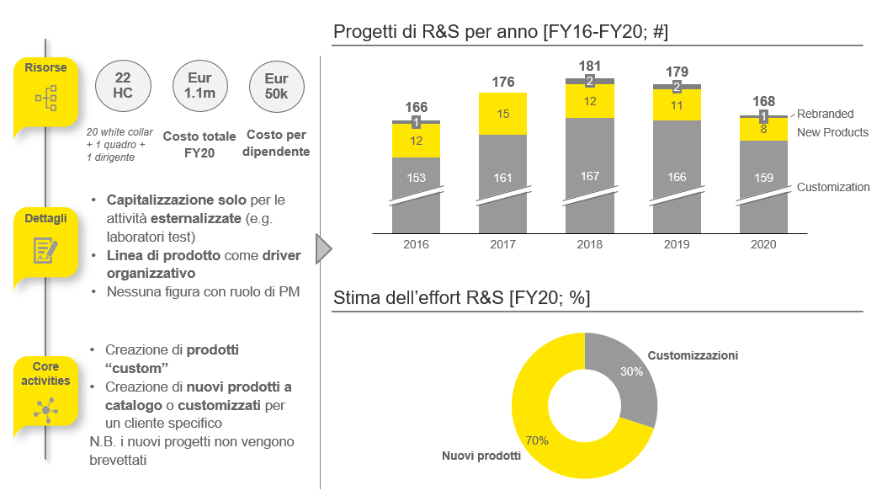

Due Diligence Activities unlocked useful insights to drive the transaction decision and the opportunities for post deal activities – EY Team involved more than one year after the deal closing
1
2
3
4
CASE STUDY: MANUFACTURING TARGET – R&D & Value Delivered (5/5)
Analyses and key insights
R&D analysis
The analysis on the R&D side served to present the number of resources dedicated to research & development activities (with related cost), the core activities as well as the historical trend of R&D projects divided into 3 main categories (rebranding, new product and customization).
The analysis also highlighted the effort dedicated to the 3 types of projects in order to understand which activity was the most time and cost consuming
Operational Due Diligence activities (4 weeks) provided useful insights to drive the transaction related decision and highlighted opportunities for post-deal activities
Based on the evidence provided, the Client decided to go beyond the due diligence activities, involving the EY team also for:
developing the Day 1 readiness Plan
assisting in the assessment of the carve-out of internal business unit, to be merged with the Target
defining and monitoring the 100 days integration plan
identifying value creation opportunities and supporting the related execution
POST-DEAL SUPPORT LASTED 12+ MONTHS
Value Delivered
Reliance restricted and confidential – Only for Internal Use

Slide 14
Agenda
1
Operational and Tech Due Diligence roles and areas of analysis
2
Operational Due Diligence
3
4
Tech Due Diligence
Credentials and CVs
Key benefits and areas of analysis
Scope of Work – Example
Timeline
Case Study: Manufacturing Target
Reliance restricted and confidential – Only for Internal Use

Slide 15




Tech Due Diligence provides a clear visibility of the IT capability to support current and target business model, highlighting separation and integration cost while identifying areas of optimization and value creation
1
2
3
4
Key benefits and areas of analysis
MAIN GOAL
Tech Due Diligence analyses the alignment between business strategy and IT, identifies technological constraints and risks that could undermine value creation and helps spotting potential optimizations
Key areas of analysis
Technological Landscape
Assesses technological capability to enable business goals in terms scalability, maintainability and security
IT Operating Model & Organization
KEY BENEFITS
Understands IT organizational skills and delivery capability, identifying also potential risks associated with suppliers (i.e. lock in, reliability) and unlocks sourcing optimization
IT Financials
Business Linkage
Compares IT Capex and Opex with industry peers to provide guidance for improvements and evaluates sustainability of IT budget forecast in light also of potential further integration / separation additional cost
Ensures the alignment of IT project portfolio with overall strategy and provides the key elements to determine the target architecture based on the maintain / evolve / replace model
Reliance restricted and confidential – Only for Internal Use

Slide 16
Tech due diligence complexity and depth can be tailored depending on the specific IT intensity of the target and based on the complexity of the IT domain
1
2
3
4
Scope of Work - Example
IT Intensity of target’s industry
Low
High
Map application landscape highlighting key manual and automated interactions and integrations
Identify manual vs automated business processes
Map infrastructure, distributed hardware and connectivity assets and lifecycle status
Identify business continuity and DR solutions
Map application landscape identifying technological domains (custom vs package, language, databases)
Architectural diagram highlighting batch vs online integrations, and technology for each architectural layer
Map infrastructure, distributed assets and connectivity assets and lifecycle status
Analyse current resources capacity and utilization and provide a growth forecast
Identify high availability, business continuity and DR solutions
Comment on the software development lifecycle methodology and toolchain
Comment on security and risk mgmt. procedures in place
Technological Landscape
Map IT organization identifying number of FTE (internal and externals)
Comment on sourcing model and on the ability of the IT organization to support current and future business model (i.e. are the suppliers able to support target scenario or transition?)
Evaluate areas / roles to be addressed in order to support separation and integration activities
Map IT organization identifying number of FTE (internal and externals, roles and skills)
Benchmark IT organizational sizing and external leverage against peers
Identify the development and maintenance sourcing model (in house / outsourcing / full outsourcing / SaaS)
Map the contracts with IT suppliers, highlighting termination clauses and SLA
Comment on incidents and software change volumes, system availability records
IT Operating Model & Organization
Comment on current and historical trend for Capex and Opex for key IT domains and asset classes
Benchmark TCO and Cashout vs industry
Provide projections for Capex and Opex and ensuring activities for separation / integration are included
Comment on current and historical trend for Capex and Opex for key IT domains and asset classes
Benchmark TCO and Cashout vs peers and industry
Evaluate and adjust budget for IT projects in pipeline, identify additional activities to be planned in light of eventual separation / integration or business model
Evaluate sustainability of IT budget and investment levels for future years
IT Financials
Identification of day 1 readiness scenario
Comment on IT Strategy in place (fit to business, completeness, how has been defined and how it is maintained, business involvement)
Identification of day 1 readiness scenario
Comments on IT Strategy vs market trends
Key users satisfaction survey
Business Linkage
Reliance restricted and confidential – Only for Internal Use

Slide 17
4 weeks is the average duration of a Tech Due Diligence, with the sharing of a Red Flag report at the end of the third week
1
2
3
4
Timeline
WEEK 1
WEEK 2
WEEK 3
WEEK 4
PRELIMINARY
ANALYSIS
Access to VDR
Red Flag Report
Final Report
Documents study
IRL preparing and sharing with the Seller
1st analysis drafting
RED FLAG
REPORT
Mgmt. Presentation
Based on documents in the VDR
Update IRL sharing
Red flag report preparation
If necessary for any deep dives
FINE-TUNING
Site visit
Deep-dive meeting with target mgmt.
Analysis fine-tuning
FINAL
SHARING
Deep-dive meeting with target mgmt.
Complete analysis
Share of final report
Milestone
Reliance restricted and confidential – Only for Internal Use

Slide 18



Tech Due Diligence has been conducted to support Crossbridge Team in the acquisition of a player operating in Oil & Gas business and consequent integration
1
2
3
4
CASE STUDY: OIL & GAS TARGET – Project overview (1/5)
Transaction Overview
Relevant KPIs
The transaction involving Crossbridge aimed to transitioning traditional energy infrastructure assets into net zero energy parks
In order to reach this goal, the Company has decided to acquire a player in the Oil & Gas market and to then perform an asset deal carve-out of all entities based in one country
The Company needed to perform Due Diligence activities to assess the “as is” situation of the potential target, including Tech DD
4 weeks of IT Due Diligence
Consolidated revenues of ~€2.5B (FY21)
+ 1200
employees
Related to transaction perimeter
Key Areas of Analysis
The aim of the Tech Due Diligence was to highlight and discuss the main areas impacted by the transaction and by the subsequent integration between the Company and the buyer
IT Strategy & projects
IT Operating Model & Organization
IT application landscape & Infrastructure
IT expenditure
IT separation
Reliance restricted and confidential – Only for Internal Use

Slide 19
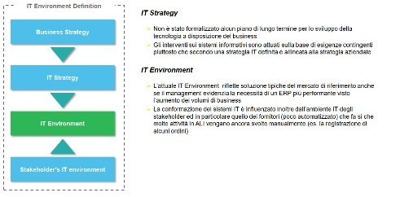
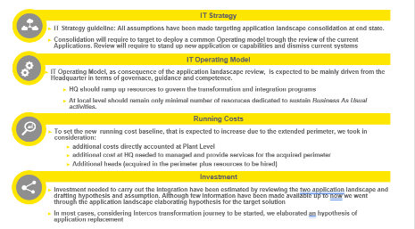
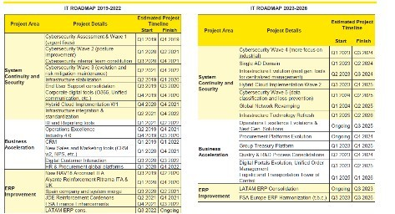
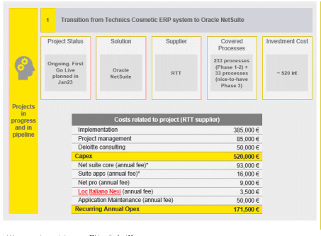
An assessment of the IT Strategy & projects was conducted to determine the role of IT within the company and assess whether this is in line with business requirements and plans
1
2
3
4
CASE STUDY: OIL & GAS TARGET – IT strategy & projects (1/5)
Analyses and key insights
IT strategy overview
An initial analysis concerned the Company’s IT Strategy assess whether this is aligned with the business strategy and whether the it adequately supports business needs
IT roadmap assessment
A deep analysis of the IT roadmap performed in relation to development of the business strategy and products/services, underlining a proper breakdown of OPEX / CAPEX allocated for each initiative completed and planned
Reliance restricted and confidential – Only for Internal Use

Slide 20
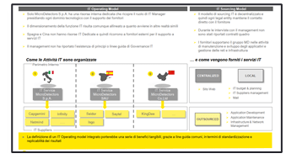
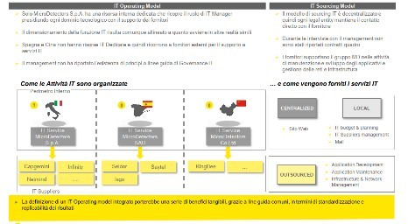
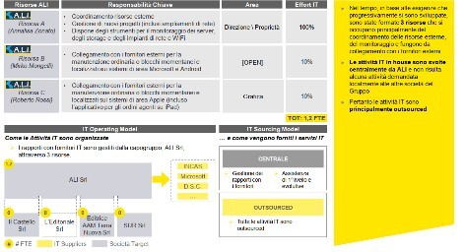
An assessment of the IT Model & Organization was conducted to understand the extent to which the IT organization supports the realization of the business strategy
1
2
3
4
CASE STUDY: OIL & GAS TARGET – IT Operating Model & Organization (2/5)
Analyses and key insights
IT Operating Model overview
An initial analysis concerned the Company's Operating Model with the geographic location of the sites (if IT not centralized), assessing supplier and third-party IT dependency and identifying any operative risks related to them
IT Organization assessment
A high-level analysis of the IT organization was conducted to understand its structure, roles and responsibilities and to assess the adequacy of the current current IT organization, including the capacity, skills and service delivery for realizing the business (growth) strategy
Reliance restricted and confidential – Only for Internal Use

Slide 21
IT application landscape and IT infrastructure analysis was performed to determine the adequacy of the current and planned applications and to assess their fit for purpose, risks and investment requirements.
1
2
3
4
CASE STUDY: OIL & GAS TARGET – IT Application landscape and Infrastructure (3/5)
Analyses and key insights
Key business applications
An assessment was conducted on the main business applications relating to:
technologies, versions, customization level and support arrangements
functionality and criticality for the business processes
change history, backlog items and foreseeable change requirements
scalability and performance efficiency (e.g. with increased number of customers, users and transactions)
potential limitations of interfacing (e.g. private APIs)
maintainability, reliability and related quality assurance measures
issues and issue resolution time
IT infrastructure
Infrastructure HW analysis was conducted to map purchase price, date of purchase and replacement policy, HW ownership, support arrangement, scalability and its reliability
Reliance restricted and confidential – Only for Internal Use

Slide 22
Analysis on IT expenditure was useful to understand the trend of historical expenses and the forecast IT budget. It is also useful to identify any underinvestment in the IT organization and landscape.
1
2
3
4
CASE STUDY: OIL & GAS TARGET – IT expenditure (4/5)
Analyses and key insights
IT expenditure analysis
The analysis of the historical, current and forecast IT CAPEX and OPEX was performed:
commenting whether the level is sustainable and comparable to peers
identifying any unplanned Capex investments (e.g. remediate out-of-support technologies)
commenting on the effectiveness of recent IT investments in increasing operational efficiency and reducing operating expenses
quantifying any required adjustments to the ongoing IT Opex (e.g. reinstate support with vendors or upgrade out-of-support systems)
Benchmarking
Evaluate the current Target position, in terms of IT expenditure, according to internal EY benchmarks related to its sector
Reliance restricted and confidential – Only for Internal Use

Slide 23
Due Diligence Activities unlocked useful insights to drive the transaction decision and the opportunities for post deal activities
1
2
3
4
CASE STUDY: OIL & GAS TARGET – IT separation (5/5)
Analyses and key insights
IT separation analysis
Carve-out and standalone analysis are requested to:
Understand IT assets and resources that are included in the transaction and will be transferred to the Buyer and those that need to be replaced
Comment Target’s current run rate (direct and allocated expenses), one-time IT cost estimates for Day 1 separation, including assumptions and supporting calculations
Preliminary comments on TSA approach as proposed by the Seller (duration, associated costs) in order to identify potential risks and/or gaps
Tech Due Diligence activities (4 weeks) provided useful insights to drive the transaction related decision and highlighted opportunities for post-deal activities
Based on the evidence provided, the Client decided to go beyond the due diligence activities, involving the EY team also for:
developing the Day 1 readiness Plan
assisting in the assessment of the carve-out of internal business unit, to be merged with the Target
defining and monitoring the 100 days integration plan
identifying value creation opportunities and supporting the related execution
Value Delivered
Reliance restricted and confidential – Only for Internal Use

Slide 24
Agenda
1
Operational and Tech Due Diligence roles and areas of analysis
2
Operational Due Diligence
3
4
Tech Due Diligence
Credentials and CVs
Reliance restricted and confidential – Only for Internal Use

Slide 25


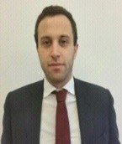

We have a dedicated Team with relevant track record in Operational and Tech Due Diligence Projects
1
2
3
4
Subhead saw sea without
EY Team
Relevant information
EY Team
All-round operational and tech approach
Coordination
Main Referent
Sector expertise
✓
✓
EY
Dedicated team of senior consultants
EY
Broad knowledge of the Operational and Tech Key topics
Giuseppe Donatelli
(Partner)
Coordinating the core execution team
✓
✓
Senior Manager
EY
Market leader with outstanding track record
EY
Broad experience in Operation and Tech Due Diligence Projects
Stefano Tavoni
(OPS DD - Focus on Corporate)
Luca
Bishara
(OPS DD - Focus on PE)
Michele
Brindani
(Focus on Tech)
=
Value for our clients
Senior and Junior consultants with extensive previous experience on Operation and Tech Due Diligence services
Page 25
Reliance restricted and confidential – Only for Internal Use

Slide 26
1
2
3
4
Gisueppe Donatelli
Partner
EYP, Strategy & Transactions - Transaction Strategy & Execution’ department leader
Mobile +39 335 7678479
Email giuseppe.donatelli@parthenon.ey.com
Background
Giuseppe is a Partner within EY’s ‘Strategy & Transaction’ service line, and he is leading both the Telecom-Media-Technology Sector and the ‘Transaction Strategy & Execution’ department
Before joining EY in 2008, he worked for 12 years within the Telecom & Technology industry in different multinational companies and corporate.
Education
Giuseppe received a B.S. in Electronic Engineering, an ICT Master and an Executive M.B.A. He speaks English fluently also because he spent some job periods in Europe and South America for international projects within Telecom Italia Group.
Professional Experience
Responsible for several Operational and IT Due Diligence engagements, including among the others:
Operational and IT DD for Datalogic, in relation to the acquisition of a Italian target
Operational and IT DD for Antin IP (Anglo-French PE) in relation to the acquisition of Grandi Stazioni Retail to be carved out from FS Group;
Operational assessment for Hitachi Railways in relation to the acquisition of AnsaldoBreda from Finmeccanica;
Operational and IT assessment for a leading Italian multiutility in relation to the acquisition of a perimeter from E.On Italian business
Led several carve out projects including the Operational and IT assessment, design and coordination of post deal execution plan, including among the others:
IT assessment and operational support for Baker Hughes in relation to the IT carve out from GE Group;
Carve-out assessment, design and execution for Daimler Group in relation to the set up of one legal entity per each single Italian Business Unit (Car&Van, Truck, Bus, etc);
Business & Operational assessment for Vodafone Group related to the preparation of Tower Business Units to be carved out in 7 European Countries
Carve-out of INWIT from Telecom Italia Group, including the stabilization/optimization plan for processes and systems after the IPO (36 months)
Led several post-merger integration projects including the IT assessment, preparation, execution of IT infrastructure/systems/applications, including among the others:
Project Management Office (PMO) for the integration project (21 months) of two Italian companies providing mobility services for BMW Group, with specific focus on the IT platform;
Integration Management Office for A2A Group in relation to the acquisition of 2 generation plants (9 months);
Worked for four years (2004-2008) for SIEMENS Italy as Head of 'Project Management' Unit at the 'Enterprise Communications' Italian Division, providing ICT solutions to Top Clients
Worked for three years (2001-2004) for ACANTHO SpA – Broadband Service Provider (fiber optic and DataCenter) of HERA Group - a major Italian Multi-Utility company - where he was the Head of the 'Institutional & Captive market' and the Project Manager for the ‘Development of the broadband network’ together with the local Regional Government
Worked for five years (1996-2001) for the TILAB (ex CSELT), the Research & Development Center of TELECOM ITALIA Group, as Project Manager for the 'Strategic Planning support to TIM’ in Italy, Europe (e.g. Greece, Spain), Southern America (e.g. Bolivia, Chile)
Reliance restricted and confidential – Only for Internal Use

Slide 27
1
2
3
4
Stefano Tavoni
Senior Manager
EYP, Strategy & Transactions - Transaction Strategy & Execution
Mobile +39 334 7218141
Email stefano.tavoni@parthenon.ey.com
Background
Stefano is Senior Manager within the Transaction Strategy & Execution practice
Stefano has more than ten years of experience as Management Consultants and worked on several cost optimization programs for large multinationals within the following industries: Telecommunications, Financial services, Industrial
Education
Stefano holds a Master Degree in Aerospace Engineering and obtained Lean Six Sigma Black belt certification. He speaks English fluently also because he spent some job periods in Europe and Middle East for international project
Professional Experience
Operational Due Diligence of an Italian producers of Hygiene products: i) Organization and Operating Model, ii) Procurement Strategy, iii) Manufacturing and logistic footprint, iv) Productivity and utilization, v) R&D
Operational Due Diligence for the carve-out of a business unit of a Tier 1 operator in the Automotive industry: i) Organization and Operating Model, ii) operational gaps to be fulfilled and related risks and mitigations, iii) map of all services to be exchanged between the carved out perimeter and Mother Company
Operational Due Diligence of a Global producers of Hygiene products: i) Organization and Operating Model, ii) Procurement Strategy, iii) Manufacturing and logistic footprint, iv) Productivity and utilization, v) R&D
Carve-out perimeter definition for a global Steelworks: stand alone assessment (processes, person, tools, contracts, …), gaps identification and action plan definition
Carve-out perimeter definition for a global technology leader in the factory automation market: stand alone assessment (processes, person, tools, contracts, …), gaps identification and action plan definition
Carve-out perimeter definition for an Italian telco player: operational and economical assessment of player divisions, definition of carve-out perimeter and related business case
Post Merge & Integration support for a global technology leader in the factory automation markets: 100 days integration plan definition, identification of value creation initiatives and support in the implementation phase
Working capital optimization for an European wellness machineries producer: design of a traceability model, fully integrated with its RPA, able to track products step by step, allowing also a real-time visibility of stocks along all the supply chain
Plant turnaround for a Leading European producer of components for automotive sector: identification of root causes associated to current plant performances, definition of improvement levers with associated impact and responsibilities
Costs reduction initiative for a Leading company in security service: assessment of “order to cash” process, adopting DMAIC approach from Lean Six Sigma Methodology
Carve-out support for a Leading Italian payments provider: operational assessment (processes, tools and KPIs), gaps identification, action plan definition, support to the implementation phase
Organization structure simplification for an Italian leading bank: design of the new organizational and operational model leveraging on a Zero Based Approach
Re-design of Client's organizational and operational model for an Italian leading private bank: definition of operating model blue-print, identification of gaps with respect to market best practices, set the evolution roadmap (e.g.: Outsourcing program, Lean Six Sigma program,…)
Reliance restricted and confidential – Only for Internal Use

Slide 28

1
2
3
4
Luca Bishara
Senior Manager
EYP, Strategy & Transactions - Transaction Strategy & Execution
Mobile +39 339 7339495
Email luca.bishara@parthenon.ey.com
Background
Luca is a Manager at EY-Parthenon and part of the Transaction Strategy & Execution department
He is also involved in the Industrial Products market segment
Before joining EY, he worked in a Milan-based consulting firm where he was mainly involved in Corporate Finance activities such as Business Modelling, Carve out projects, and Transaction Support, for a total experience of 7 years
Luca’s mother tongue is Italian and he is fluent in English, also thanks to several international projects. He has also an intermediate knowledge of Spanish
Education
His competence is focused on business and financial planning activities, financial modelling, accounting and carve out
He gained a significant experience in several transaction-related activities, both pre-deal and post deal
Professional Experience
Luca was involved in a number of Operational Due Diligence and synergies assessments
He performed a significant number of Business Plans aimed at assessing financial requirements for the implementation of strategic initiatives. He drafted from scratch several industrial plans with a specific focus on Top Line assumptions, cost structure and cash flows
He drafted the financials for the carve-out of a Business Unit of a company involved in the air conditioning field in a transaction perspective
He supported an Italian ICT player during the post merger integration process involving 20+ companies. Main activities: i) cost structure optimization; ii) financial monitoring and reporting; iii) cooperation with key stakeholder at Group and BU level in order to develop the integration plan
Luca conducted a feasibility study for a leading Italian Fintech player in order to assess the opportunity of the launch of a new business unit, including market assessment, business and operational model selection, and a detailed bottom-up business case
He drafted an industrial plan for an Italian ICT player in order to assess the feasibility of different strategic options
He performed several Independent Business Review and Working Capital Assessments for IPO processes in the Italian Stock Exchange
He drafted and supported the monitoring of a short term cash flow forecast model for an industrial player
He performed scouting analyses for M&A opportunities (buy-side)
He drafted Information Memorandum aimed at presenting potential investment opportunities, including the analysis of past financial performances and key market trends
Reliance restricted and confidential – Only for Internal Use

Slide 29

1
2
3
4
Michele Brindani
Senior Manager
EYP, Strategy & Transactions - Transaction Strategy & Execution
Mobile +39 334 7070277
Email michele.brindani@parthenon.ey.com
Background
Michele is a Senior Manager within EY’s Strategy & Transaction (SaT) practice
Michele has over 10 years of experience in IT consulting mainly within Financial Services, Energy & Utilities industries, with focus on Due Diligence, Operating model Transformations, Process Design, Sourcing strategy and Project Management.
Prior to Ernst & Young, Michele was a Manager at KPMG Advisory where he worked within the CIO Advisory practice
Education
Michele holds a BA and Master in Finance and Business Administration
Michele is a certified SCRUM Coach / SCRUM Master and has also PRINCE2 and ITIL v4 certifications
Fluent English and Italian native speaker
Professional Experience
Responsible for 20+ IT due diligences within financial services industry, including large and mid sized banks, payment service providers, financial institutions focused on consumer credit and NPLs, insurance brokers.
Supported the fairness opinion to evaluate the goodwill on IT assets for the merge of two large EU payment service providers
Post merge day 1 IT integration and 100 days plan. Supported the definition of the target IT architecture following the merge of two financial services providers, with specific focus on ERP and HR systems. Defined the implementation timeline and the budget to ensure the readiness at day 1 post merge.
Followed the IT stream to define the target scenarios and the Capex and Opex required to carve out a collection service business unit from a leading Italian financial service provider
Managed a feasibility study to integrate a financial services entity within the Group core banking systems - mid-sized Italian banking group
Supported the definition of the sourcing strategy and the vendor selection (including core banking systems providers) for several financial services and energy & utilities companies
Defined a 3-year IT Masterplan to include the launch of a new cloud-based CRM, estimating Capex and Opex and impacts on IT organization capacity and skills – Leading Italian consumer credit company
Coordinated the project to define the evolutive strategy of the operating model for the application development division for a mid-sized Italian bank
Supported the design of target application landscape and evolutive roadmap for an Italian Real Estate asset manager (branch of large European bank)
Supported the Improvement plan for business continuity and disaster recovery Large Italian financial institution
Supported several banks and financial institutions in projects related to payments and PSD2 regulations (including applications to Central Banks for AISP and PISP licenses)
Defined the Business Case to evaluate the evolutive scenarios of meter-to-cash technological stack for the Italian branch of a large European Energy Utility
Coordinated the design of IT Governance processes and framework and the standard Application Maintenance contractual framework for a Large Italian Energy Utility
Led the assessments and definition of the technological evolutive plan for several medium / small sized Italian Water Utilities
Coordinated the assessment and design of the target operative model of the Application Area in charge of e-trading and FX markets applications – Large Italian bank
IT Project Manager for MIFID2 regulatory upgrades on FX trading platforms – Large Italian bank
Supported the near-shoring of Trading & Post Trade Infrastructure Area – Large Italian bank
Reliance restricted and confidential – Only for Internal Use

Slide 30













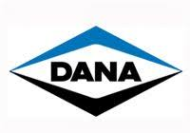





We have a deep knowledge of the Tech/Operational Due Diligence topics through numerous assignments in different industries (1/2)
1
2
3
4
Recent Selected Credentials
This announcement appears as a matter of record only
This announcement appears as a matter of record only
This announcement appears as a matter of record only
This announcement appears as a matter of record only
Datalogic
EY performed an IT and Operational Due Diligence to support Datalogic in the acquisition of a company operating in the Sensors & Safety and Machine Vision business
CVC
Ey Team assisted the PE team with Operational Due Diligence services in relation to the potential investment into Prima Solutions
Afflelou
EY performed an IT and Operational assessment in order to support the Client Team in the potential acquisition of GradVision and Vistasi
Keensight Capital
EY supported the Private Equity firm Keensight Capital with Operational Due Diligence services in relation to the investment into the “Service Business” of Axxam SpA, an Italian biotech research and discovery company
This announcement appears as a matter of record only
This announcement appears as a matter of record only
This announcement appears as a matter of record only
This announcement appears as a matter of record only
Peninsula Capital
EY was requested by Peninsula Capital Advisors to perform an operational assessment of a player focused in the Pet Care sector (“L’Isola dei Tesori”)
Aurelius
Ey Team assisted the PE team in the potential acquisition of a business unit of a Tier 1 operator in the Automotive industry
J-Hirsch
EY assisted the PE team in the potential acquisition of an operator in the production of hygiene products – IT and Operational DD activities to assess the As-Is situation of the target’s plants
Infravia Capital Partners
EY performed an Operational assessment in order to support the PE team in the potential acquisition of a provider of fiber optic connections
Tech
Operational
Reliance restricted and confidential – Only for Internal Use

Slide 31












We have a deep knowledge of the Tech/Operational Due Diligence topics through numerous assignments in different industries (2/2)
1
2
3
4
Recent Selected Credentials
This announcement appears as a matter of record only
This announcement appears as a matter of record only
This announcement appears as a matter of record only
This announcement appears as a matter of record only
OMERS/APG
EY provided buy-side IT due diligence services to OMERS Infrastructure Management and APG Asset Management in connection with the acquisition of a target in the energy industry
Hippocrates Holding
EY provided IT Due Diligence services to Hippocrates Holding in relation to the acquisition of Top Farmacia
Partners Group
EY provided IT Due Diligence services in connection of the acquisition of a majority stake of Eolo (FWA Telco Operator)
Mondadori
EY provided buy side tax, financial and IT due diligence services to Mondadori in connection with Banzai media assets, including websites Giallo Zafferano, Pianeta Donna and Studenti.it
This announcement appears as a matter of record only
This announcement appears as a matter of record only
This announcement appears as a matter of record only
This announcement appears as a matter of record only
FSI
EY provided buy-side financial and IT due diligence to Fondo Strategico Italiano in connection with the acquisition of a minority in Cedacri, software developer
Aurelius
EY provided buy-side IT due diligence services to TBG Holdings in connection with the acquisition of PetrolValves Srl
Prenatal
EY provided buy side IT due diligence services to Prenatal SpA for the acquisition of ToysRUs offices and shops in Portugal and Spain
Intercos
EY Provided IT Due Diligence and IT Integration feasibility services in the tentative acquisition of US local activities from Coty
Tech
Operational
Reliance restricted and confidential – Only for Internal Use

Slide 32








As anticipated by Datalogic Case, Tech/Operational Due Diligence can be the input for relevant post deal activities (1/2)
1
2
3
4
Selected Credentials
This announcement appears as a matter of record only
This announcement appears as a matter of record only
This announcement appears as a matter of record only
This announcement appears as a matter of record only
KKR
EY supported KKR for the IT and Operational DD and the Target Operating Model analysis in relation to the investment into a company focused on fixed access network (FiberCop)
Antin IP
EY provided an Operational Due Diligence for Antin IP (Anglo-French PE) in relation to the acquisition of Grandi Stazioni Retail to be carved out from FS Group
Hitachi Railways
EY provided Operational assessment for Hitachi Railways in relation to the acquisition of AnsaldoBreda from Finmeccanica
A2A
EY was requested by a leading Italian multiutility to perform an Operational DD related to an investment of a perimeter of E.On
Post deal activities
6 months support
to implement the new IT/organizational structure and the IT/operating systems
12 months support
to redefine the forecast model, the budget and control plan, the purchase and operation systems policies
3 months support
to perform the day one readiness with a specific focus on the governance model
12 months support
to define the E.on carve-out model, and subsequent integration in A2A
Tech
Operational
Reliance restricted and confidential – Only for Internal Use

Slide 33


As anticipated by Datalogic Case, Tech/Operational Due Diligence can be the input for relevant post deal activities (2/2)
1
2
3
4
Selected Credentials
This announcement appears as a matter of record only
This announcement appears as a matter of record only
This announcement appears as a matter of record only
Barclays
EY provided sell-side support during pre-deal phase for the divestment of the retail banking business across different work streams including IT, Operations. EY provided post deal support for separation delivery
Trinseo
EY Provided IT Integration Services in connection of the acquisition of majority stake of API – an Italian producer
Baker Hughes
Provided support several services to Baker Hughes IT M&A office. Services included Integration and Due Diligence support, definition of TSA and stranded costing methodology and tools, process definition for IT cost collection
Post deal activities
12 months support
to implement the new IT/organizational structure and the IT/operating systems
6 months support
to redefine the forecast model, the budget and control plan, the purchase and operation systems policies
12 months support
to perform the day one readiness with a specific focus on the governance model
Tech
Operational
Reliance restricted and confidential – Only for Internal Use

Slide 34
EY | Assurance | Tax | Transactions | Advisory
About EY
EY is a global leader in assurance, tax, transaction and advisory services. The insights and quality services we deliver help build trust and confidence in the capital markets and in economies the world over. We develop outstanding leaders who team to deliver on our promises to all of our stakeholders. In so doing, we play a critical role in building a better working world for our people, for our clients and for our communities.
EY refers to the global organization, and may refer to one or more, of the member firms of Ernst & Young Global Limited, each of which is a separate legal entity. Ernst & Young Global Limited, a UK company limited by guarantee, does not provide services to clients. For more information about our organization, please visit ey.com.
© 2022 EYGM Limited. All Rights Reserved.
GA 1010196
ED None
This material has been prepared for general informational purposes only and is not intended to be relied upon as accounting, tax or other professional advice. Please refer to your advisors for specific advice.
ey.com/oilandgas

